Slide 1
Enhanced/Extended Entity Relationship Modelling
Kapukha

Slide 2
Chapter Objectives
The limitations of the basic concepts of the Entity–Relationship (ER) model and the requirements to represent more complex applications using additional data modeling concepts
The most useful additional data modeling concepts of the Enhanced Entity–Relationship (EER) model called specialization/generalization, aggregation, and composition.
A diagrammatic technique for displaying specialization/generalization, aggregation, and composition in an EER diagram using the Unified Modeling Language (UML).

Slide 3
Enhanced Entity Relationship
The ER model supported with additional semantic concepts/constructs is called the Enhanced Entity–Relationship (EER) model.
EER model describes three of the most important and useful additional concepts namely specialization/generalization, aggregation, and composition.
The concept of specialization/generalization is associated with special types of entities known as superclasses and subclasses, and the process of attribute inheritance.
Entity type represents a set of entities of the same

Slide 4
Superclasses/Subclasses
A superclass is an entity type that includes one or more distinct subgroupings of its occurrences, which require to be represented in a data model.
A subclass is distinct subgrouping of occurrences of an entity type, which require to be represented in a data model.
For example, the entities that are members of the Staff entity type may be classified as Manager, SalesPersonnel, and Secretary. In other words, the Staff entity is referred to as the superclass of the Manager, SalesPersonnel, and Secretary subclasses
The relationship between a superclass and any one of its subclasses is called a superclass/subclass relationship. For example, Staff/Manager has a superclass/subclass relationship.

Slide 5
Superclass/Subclass Relationships
Each member of a subclass is also a member of the superclass.
In other words, the entity in the subclass is the same entity in the superclass, but has a distinct role.
The relationship between a superclass and a subclass is one-to-one (1:1) and is called a superclass/subclass relationship
Some superclasses may contain overlapping subclasses: A case where a staff is a Dean and Lecturer are overlapping subclasses of the Staff superclass
On the other hand, not every member of a superclass need be a member of a subclass; for example, members of staff without a distinct job role

Slide 6
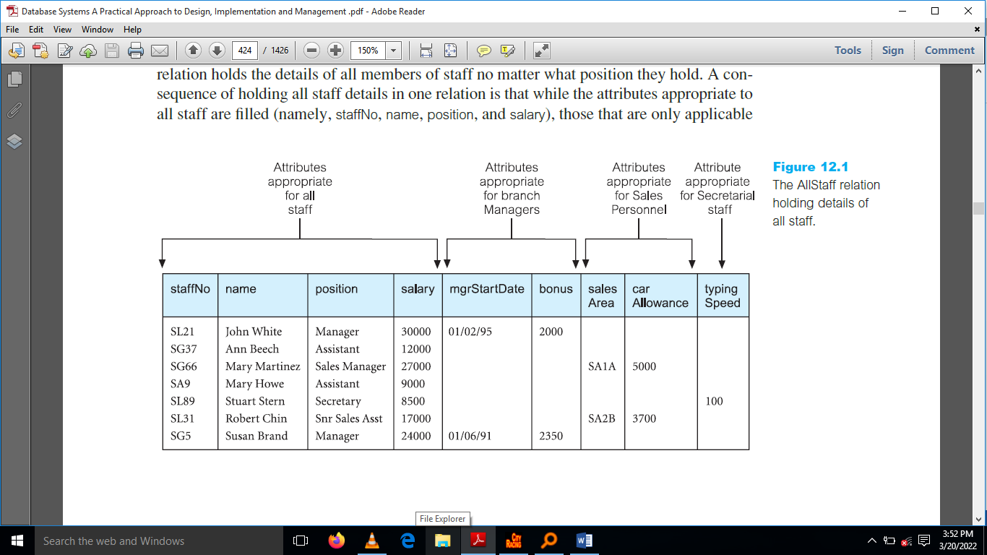
Need for EERM

Slide 7
Why we need EERM
There are two important reasons for introducing the concepts of superclasses and subclasses into an ER model.
1.It avoids describing similar concepts more than once, thereby saving time for the designer and making the ER diagram more readable.
2.It adds more semantic information to the design in a form that is familiar to many people. For example, the assertions that ‘Manager IS-A member of staff’ and ‘flat IS-A type of property’, communicates significant semantic content in a concise form.
3. It avoids unnecessary nulls

Slide 8
Attribute Inheritance
An entity in a subclass represents the same ‘real world’ object as in the superclass, and may possess subclass-specific attributes, as well as those associated with the superclass.
The property of inheritance enables an entity subtype to inherit the attributes and relationships of the supertype.
A supertype contains those attributes that are common to all of its subtypes. In contrast, subtypes contain only the attributes that are unique to the subtype.
One important inheritance characteristic is that all entity subtypes inherit their primary key attribute from their supertype.

Slide 9
Type Hierachies
Type hierarchies are known by a variety of names including:
Specialization hierarchy (for example, Manager is a specialization of Staff)
Generalization hierarchy (for example, Staff is a generalization of Manager), and
IS-A hierarchy (for example, Manager IS-A (member of Staff).
A subclass with more than one superclass is called a shared subclass.
In other words, a member of a shared subclass must be a member of the associated superclasses.
As a consequence, the attributes of the superclasses are inherited by the shared subclass, which may also have its own additional attributes. This process is referred to as multiple inheritance.

Slide 10
Specialization Process
The process of maximizing the differences between members of an entity by identifying their distinguishing characteristics.
Specialization is a top-down approach to defining a set of superclasses and their related subclasses it depicts the arrangement of higher-level entity supertypes (parent entities) and lower-level entity subtypes (child entities).
The set of subclasses is defined on the basis of some distinguishing characteristics of the entities in the superclass
When we identify a set of subclasses of an entity type, we then associate attributes specific to each subclass (where necessary), and also identify any relationships between each subclass and other entity types or subclasses (where necessary).

Slide 11
Specialization Process
Entity subtypes inherit all relationships in which the supertype entity participates.
For example, an EMPLOYEE entity supertype participating in a 1:M relationship with a DEPENDENT entity.
Through inheritance, all subtypes also participate in that relationship.
In specialization hierarchies with multiple levels of supertype/subtypes, a lower-level subtype inherits all of the attributes and relationships from all of its upper-level supertypes.

Slide 12
Generalization Process
The process of minimizing the differences between entities by identifying their common characteristics.
The process of generalization is a bottom-up approach, which results in the identification of a generalized superclass from the original entity types.
If we apply the process of generalization on these entities, we attempt to identify similarities between them such as common attributes and relationships.
As the process of generalization can be viewed as the reverse of the specialization process, we refer to this modeling concept as ‘specialization/generalization’.

Slide 13
Diagrammatic representation of specialization/generalization
As the process of generalization can be viewed as the reverse of the specialization process we refer to this modeling concept as ‘specialization/generalization’.
The label below the specialization/generalization triangle, shown as {Optional, And}, describes the constraints on the relationship between the superclass and its subclasses.
Attributes that are specific to a given subclass are listed in the lower section of the rectangle representing that subclass
Attributes that are common to all subclasses are listed in the lower section of the rectangle representing the superclass

Slide 14
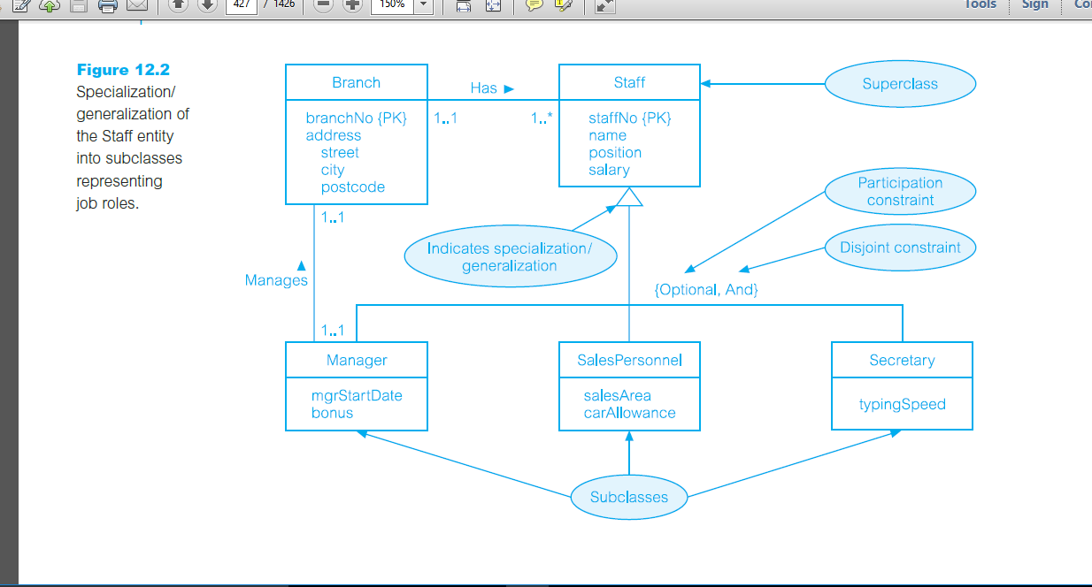

Slide 15
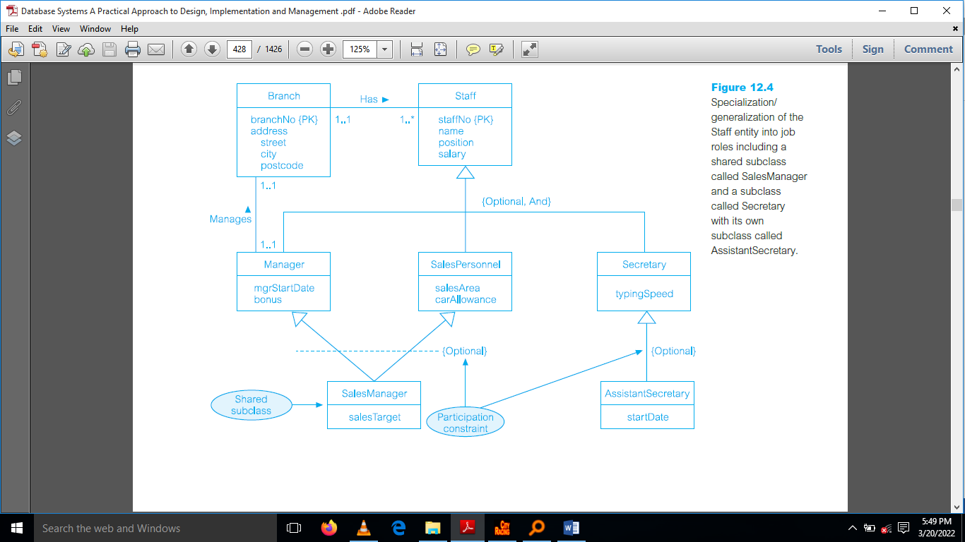

Slide 16
Constraints on Specialization/Generalization
There are two constraints that may apply to a specialization/generalization called participation constraints and disjoint constraints.
Participation / Completeness Constraint
Determines whether every member in the superclass must participate as a member of a subclass.
The completeness constraint specifies whether each entity supertype occurrence must also be a member of at least one subtype.
A participation/completeness constraint may be mandatory/total or optional/partial.
A superclass/subclass relationship with mandatory participation specifies that every member in the superclass must also be a member of a subclass (Employee terms of employment).

Slide 17
Diagrammatic Representation
To represent mandatory/total participation, ‘Mandatory’ is placed in curly brackets below the triangle that points towards the superclass.
Mandatory/total completeness (symbolized by a circle over a double line) means that every supertype occurrence must be a member of at least one subtype.
A superclass/subclass relationship with optional participation specifies that a member of a superclass need not belong to any of its subclasses.
To represent optional/partial participation, ‘Optional’ is placed in curly brackets below the triangle that points towards the superclass.
Optional/Partial completeness (symbolized by a circle over a single line) means that not every supertype occurrence is a member of a subtype; that is, there may be some supertype occurrences that are not members of any subtype.

Slide 18
Disjoint/Overlapping Constraints
Describes the relationship between members of the subclasses and indicates whether it is possible for a member of a superclass to be a member of one, or more than one, subclass.
Disjoint subtypes, also known as nonoverlapping subtypes, are subtypes that contain a unique subset of the supertype entity set; in other words, each entity instance of the supertype can appear in only one of the subtypes
The disjoint constraint only applies when a superclass has more than one subclass.
If the subclasses are disjoint, then an entity occurrence can be a member of only one of the subclasses.

Slide 19
Overlapping Subtypes
To represent a disjoint superclass/subclass relationship, ‘Or’ is placed next to the participation constraint within the curly brackets
Overlapping/nondisjoint subtypes are subtypes that contain nonunique subsets of the supertype entity set; that is, each entity instance of the supertype may appear in more than one subtype.
For example, in a university environment, a person may be an employee or a student or both.
In turn, an employee may be a professor as well as an administrator.
If subclasses of a specialization/generalization are not disjoint (called nondisjoint),then an entity occurrence may be a member of more than one subclass.
To represent a nondisjoint superclass/subclass relationship, ‘And’ is placed next to the participation constraint within the curly brackets.

Slide 20
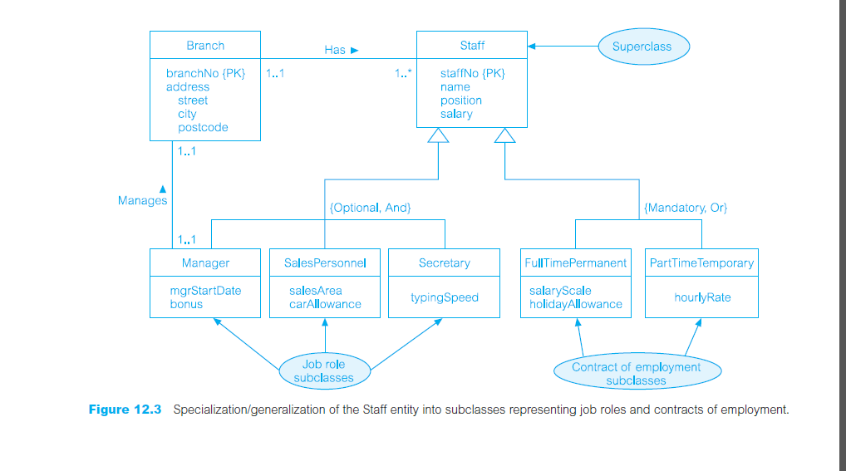

Slide 21
FOUR CATEGORIES
The disjoint and participation constraints of specialization and generalization are distinct, giving rise to four categories:
‘mandatory and disjoint’,
‘optional and disjoint’,
‘mandatory and nondisjoint’, and
‘Optional and nondisjoint’.

Slide 22
Aggregation
Represents a ‘has-a’ or ‘is-part-of’ relationship between entity types, where one represents the ‘whole’ and the other the ‘part’.
A relationship represents an association between two entity types that are conceptually at the same level. Sometimes we want to model a ‘has-a’ or ‘is-part-of’ relationship, in which one entity represents a larger entity (the ‘whole’), consisting of smaller entities (the ‘parts’).
This special kind of relationship is called an aggregation.
Aggregation does not change the meaning of navigation across the relationship between the whole and its parts, nor does it link the lifetimes of the whole and its parts.
An example of an aggregation is the Has relationship, which relates the Branch entity (the ‘whole’) to the Staff entity (the ‘part’).

Slide 23
Diagrammatic representation of aggregation
UML represents aggregation by placing an open diamond shape at one end of the relationship line, next to the entity that represents the ‘whole’.
Composition
A specific form of aggregation that represents an association between entities, where there is a strong ownership and coincidental lifetime between the ‘whole’ and the ‘part’.
Aggregation is entirely conceptual and does nothing more than distinguish a ‘whole’ from a ‘part’.
However, there is a variation of aggregation called composition that represents a strong ownership and coincidental lifetime between the ‘whole’ and the ‘part’

Slide 25
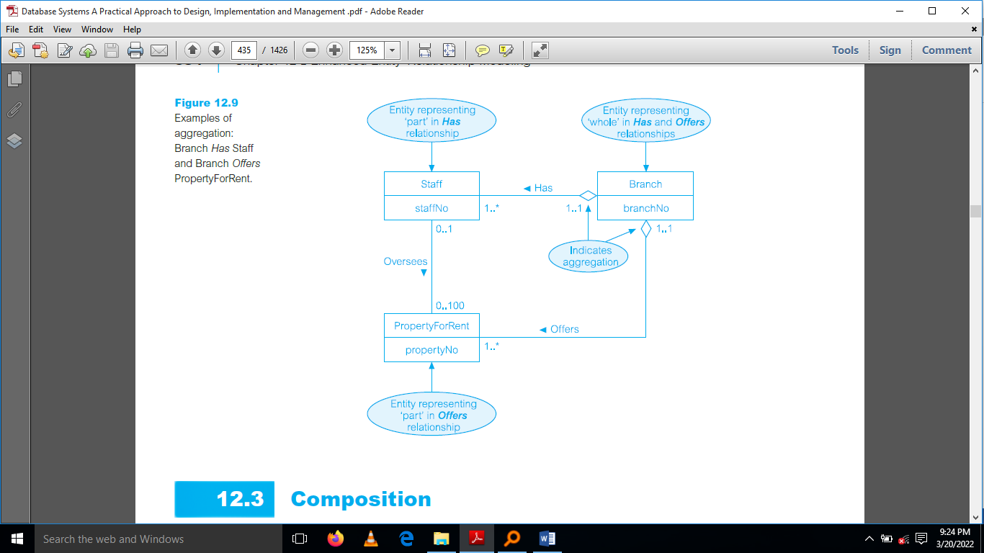

Slide 26
Composition
In a composite, the ‘whole’ is responsible for the disposition of the ‘parts’, which means that the composition must manage the creation and destruction of its ‘parts’.
In other words, an object may only be part of one composite at a time.
For the purposes of discussion, consider an example of a composition, namely the Displays relationship, which relates the Newspaper entity to the Advert entity.
As a composition, this emphasizes the fact that an Advert entity (the ‘part’) belongs to exactly one Newspaper entity (the ‘whole’).
This is in contrast to aggregation, in which a part may be shared by many wholes. For example, a Staff entity may be ‘a part of’ one or more Branches entities

Slide 27
Diagrammatic representation of composition
UML represents composition by placing a filled-in diamond shape at one end of the relationship line next to the entity that represents the ‘whole’ in the relationship.
For example, to represent the Newspaper Displays Advert composition, the filled-in diamond shape is placed next to the Newspaper entity, which is the ‘whole’ in this relationship.

Slide 28
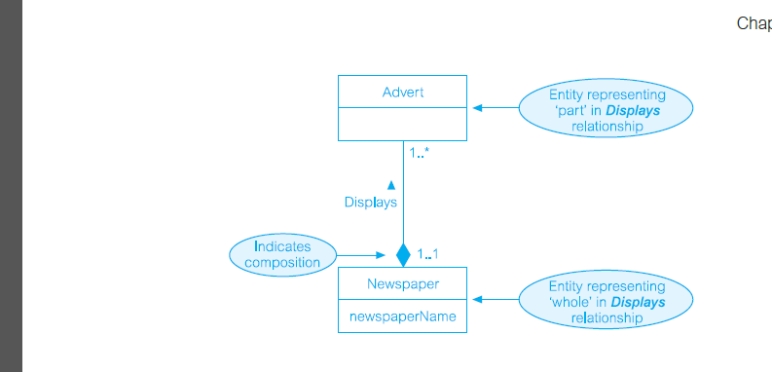

Slide 29
ENTITY CLUSTERING
An entity cluster is a “virtual” entity type used to represent multiple entities and relationships in the ERD.
An entity cluster is formed by combining multiple interrelated entities into a single abstract entity object.
An entity cluster is considered “virtual” or “abstract” in the sense that it is not actually an entity in the final ERD.
Instead, it is a temporary entity used to represent multiple entities and relationships, with the purpose of simplifying the ERD and thus enhancing its readability.

Slide 30
SELECTING PRIMARY KEYS
the most important characteristic of an entity is its primary key (a single attribute or some combination of attributes), which uniquely identifies each entity instance. The primary key’s function is to guarantee entity integrity.
Therefore, the importance of properly selecting the primary key has a direct bearing on the efficiency and effectiveness of database implementation
A natural key or natural identifier is a real-world, generally accepted identifier used to distinguish—that is, uniquely identify—real-world objects. As its name implies, a natural key is familiar to end users and forms part of their day-to-day business vocabulary.
Usually, if an entity has a natural identifier, a data modeler uses that as the primary key of the entity being modeled. Generally, most natural keys make acceptable primary key identifiers.

Slide 31
Primary Key Guidelines
Unique values - The PK must uniquely identify each entity instance. A primary key must be able to guarantee unique values. It cannot contain nulls.
Nonintelligent - The PK should not have embedded semantic meaning other than to uniquely identify each entity instance.
No change over time - If an attribute has semantic meaning, it might be subject to updates. This is why names do not make good primary keys.
Preferably single-attribute - A primary key should have the minimum number of attributes possible (irreducible). Single-attribute primary keys are desirable but not required.
Preferably numeric - Unique values can be better managed when they are numeric, because the database can use internal routines to implement a counter-style attribute that automatically increments values with the addition of each new row.
Security-compliant-The selected primary key must not be composed of any attribute(s) that might be considered a security risk or violation.

Slide 32
Discussion
When to Use Composite Primary Keys
When to Use Surrogate Primary Keys
#### END

